Slide 1
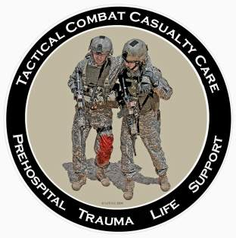
Tactical Combat Casualty Care for Medical Personnel August 2018 (Based on TCCC-MP Guidelines 180801)
TCCC Scenarios
Notes:
We’ve talked about the basic TCCC trauma management plan.
Now let’s apply the guidelines to some selected scenarios.

Slide 2
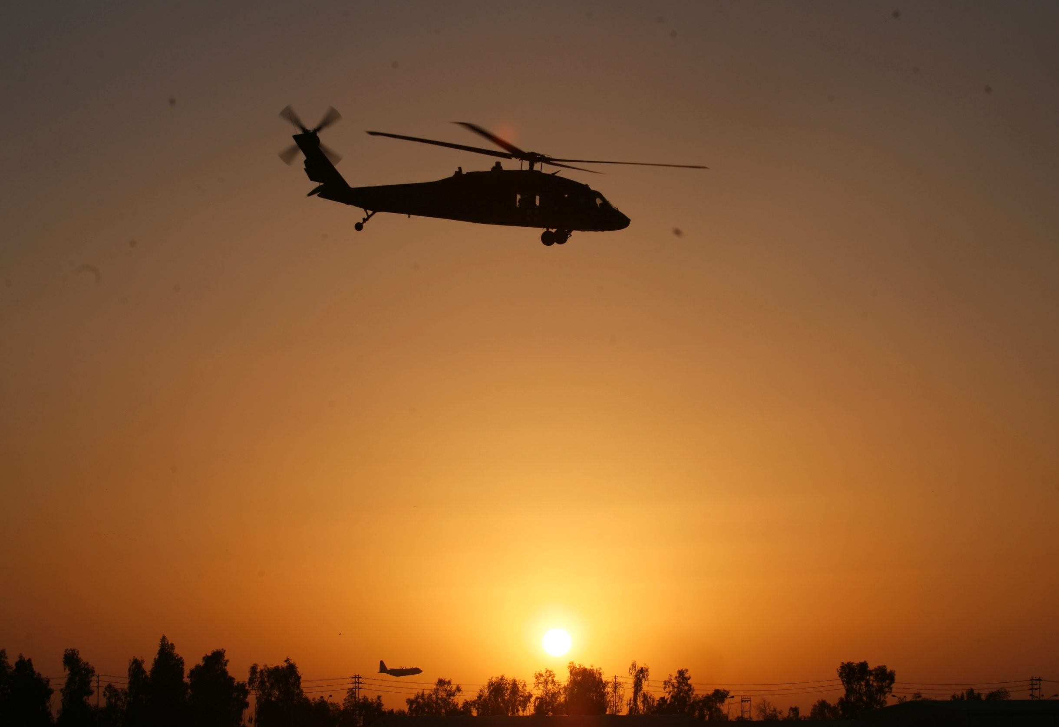
Disclaimer
“The opinions or assertions contained herein are the private views of the authors and are not to be construed as official or as reflecting the views of the Departments of the Army, Air Force, Navy or the Department of Defense.”
There are no conflict of interest disclosures.
Notes:
Read the disclaimer.

Slide 3
Learning Objective
APPLY your knowledge of TCCC to selected tactical scenarios.
Notes:
Read the text.

Slide 4
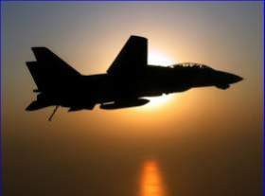
Tactical Casualty Scenarios
If the basic TCCC combat trauma management plan doesn’t work for the specific tactical situation, then for combat medics, corpsmen, and PJs – it doesn’t work.
There are no rigid guidelines for combat tactics – THINK ON YOUR FEET.
Scenario-based planning is critical for success in TCCC
Examples to follow:
Notes:
Read the text.

Slide 5
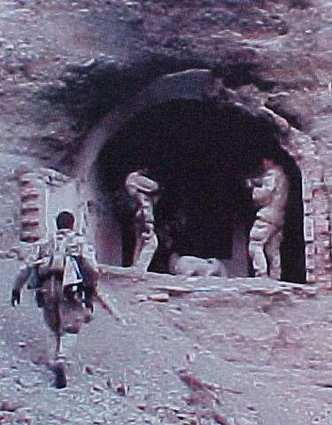
SEAL Casualty - Afghanistan
August 2002
Somewhere in Afghanistan
SEAL element on direct action mission
Story of the casualty as described by the first responder – NOT a
corpsman
Notes:
This is a real story that dramatically illustrates the difficulty of trauma care on the battlefield.
This represents the state of prehospital trauma care early in the war in Afghanistan.

Slide 6
SEAL Casualty - Afghanistan
“There were four people in my team, two had been shot. Myself and the other uninjured teammate low crawled to the downed men. The man I came to was lying on his back, conscious, with his left leg pinned awkwardly beneath him. He was alert and oriented to person, place, time, and event. At that point I radioed C2 (mission control) to notify them of the downed man.”
Notes:
Read the text.

Slide 7
SEAL Casualty - Afghanistan
“Upon closer inspection, his knee was as big as a basketball and his femur had broken. The patient was in extreme pain and did not allow me to do a sweep of his injured leg. He would literally shove me or grab me whenever I touched his leg or wounds. I needed to find the entrance and exit wound and stop any possible arterial bleeding.”
Notes:
Read the text.

Slide 8
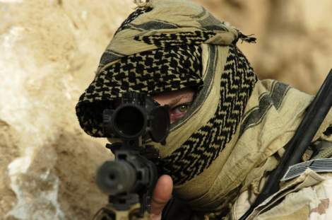
SEAL Casualty - Afghanistan
“But there was zero illumination and he was lying in a wet irrigation ditch. So I couldn’t see blood and I couldn’t feel for blood.”
Notes:
Picture yourself in this situation. You’ve got a casualty who is badly hurt and you can’t see a thing.

Slide 9
SEAL Casualty - Afghanistan
“We were also in danger because our position was in an open field (where the firefight had been) and I had to provide security for him and myself. So, I couldn’t afford to turn on any kind of light to examine his wounds. I told him to point to where he felt the pain. He had to sort through his pains.”
Notes:
Read the text.

Slide 10
SEAL Casualty - Afghanistan
“He had extreme pain in his knee and where his femur had been shattered as well as a hematoma at the site of the entrance wound (interior and upper left thigh). Finally, he pointed to his exit wound (anterior and upper left thigh). Again, I had no way of telling how much blood he had lost. But I did know that he was nonambulatory.”
Notes:
Read the text.

Slide 11
SEAL Casualty - Afghanistan
“So I called C2 again. I gave him the disposition of the patient as well as a request for casevac, a Corpsman, and additional personnel to secure my position and assist in moving the patient to the helicopter. I thought about moving the two of us to some concealment 25 meters away, but we were both really low in a shallow irrigation ditch. I felt safer there than trying to drag or carry a screaming man to concealment.”
Notes:
C2 = Command and Control

Slide 12
SEAL Casualty - Afghanistan
“Between providing security and spending a lot of time on the radio I didn’t get to treat the patient as much as I wanted to. I had given him a Kerlix bandage to hold against his exit wound. When he frantically told me that he was feeling a lot of blood, I went back to trying to treat him. I couldn’t elevate his leg. To move it would mean he’d scream in pain, which wasn’t tactical.”
Notes:
Read the text.

Slide 13
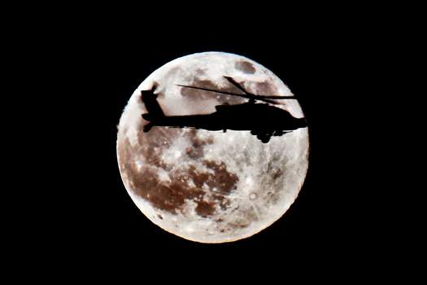
SEAL Casualty - Afghanistan
“There was just no way he would allow me to apply a pressure dressing to the exit wound even if I could locate it and pack it with Kerlix. So, I decided to put a tourniquet on him.”
Notes:
This was in 2002 – AFTER the SEALs had started to use tourniquets on the battlefield, but BEFORE they had been provided with CoTCCC-recommended tourniquets, the C.A.T. and the SOFT-T.

Slide 14
SEAL Casualty - Afghanistan
“His wounds were just low enough on his leg to get the tourniquet an inch or so above the site. I had a cravat and a wooden dowel with 550 cord (parachute cord) attached to it to use as a tourniquet. I told him to expect a lot of pain as I would be tightening the cravat down.“
Notes:
Note the makeshift tourniquet.

Slide 15
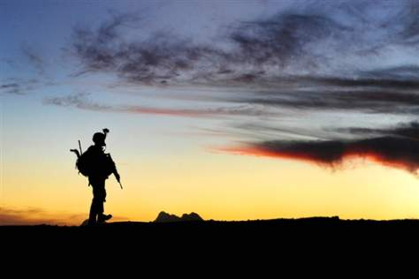
SEAL Casualty - Afghanistan
“At this point he feared for his life so he agreed. Once I got it tightened I had trouble securing it. The 550 cord was hard to get underneath the tightened cravat.”
Notes:
You need to be able to get a tourniquet on a wounded teammate with zero illumination.

Slide 16
SEAL Casualty - Afghanistan
“After over 5 minutes, the Corpsman arrived along with a CASEVAC bird and a security force. Moving the patient was very hard. Four of us struggled to move him and his gear 25 meters to the bird. The patient was over 200 pounds alone and we were moving over very uneven terrain.”
Notes:
Read the text.

Slide 17
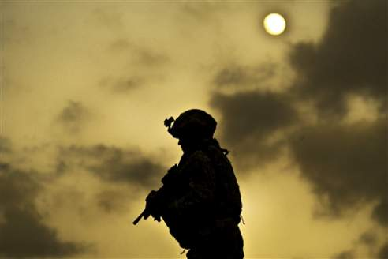
SEAL Casualty - Afghanistan
“We wanted to do a three-man carry with two men under his arms and one under his legs. But again, his leg was flopping around at the thigh and couldn’t be used to lift him.”
Notes:
Experienced combat medical personnel say that moving the casualty is typically the biggest challenge in TCCC.

Slide 18
SEAL Casualty - Afghanistan
“The bird, (a Task Force 160 MH-60) had a 50-cal sniper rifle strapped down, which made it hard for us to get him in. It took us minutes to get him 25 meters into the bird. The Corpsman went with my patient as well as the other downed man in my team and I went back to the op.”
Notes:
Was the tourniquet a good move?
Absolutely – probably saved the casualty’s life.
Would a pressure dressing have been a good idea if tolerated by the patient?
NO – won’t necessarily stop a big bleeder.

Slide 19
Scenario Discussions – Suggested Format
Break up into groups of six
Present the background for the scenario on the screen.
The Instructor will lead the group’s discussion through to the end of the scenario.
Instructor should have a printout of the speaker notes to lead the session.
10 minutes per scenario
Stop after 10 minutes and present next scenario on screen
Notes:
Here’s is a suggested format for the scenario discussions
Get the class talking and thinking on these!

Slide 20
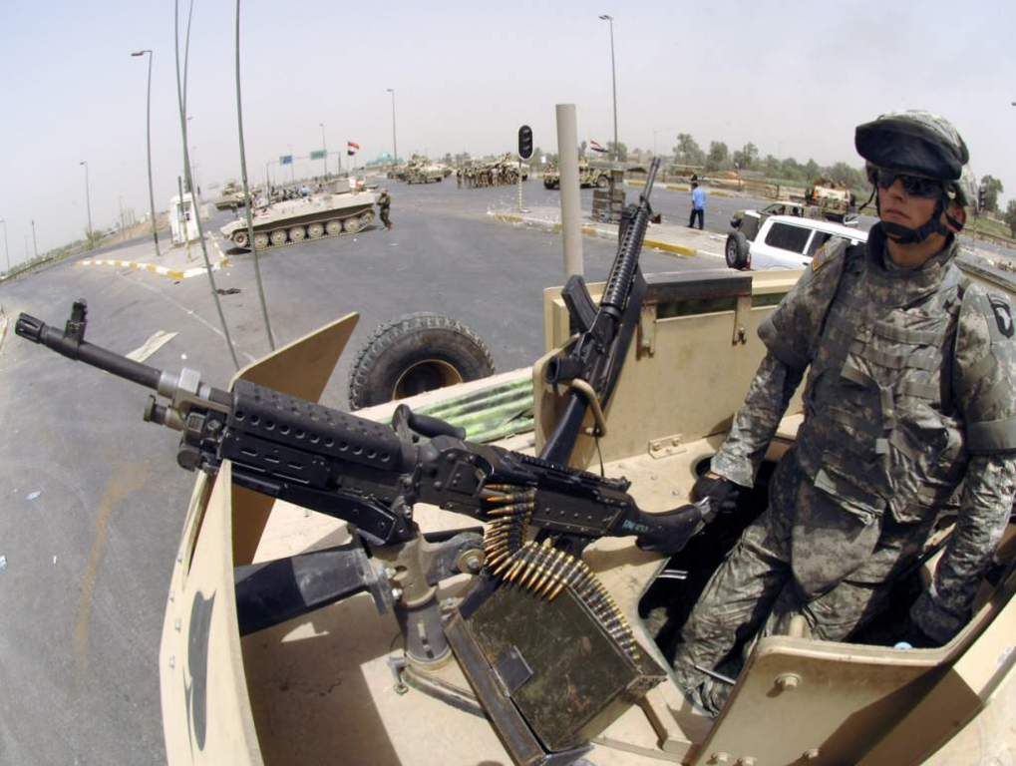
Urban Warfare Scenario
Notes:
Now let’s look at a scenario in urban warfare operations.

Slide 21
Real-World Scenario
High-threat urban environment
16-man Ranger team
70-foot fast rope insertion for building assault
One man misses rope and falls
Unconscious on the ground
Bleeding from mouth and ears
Unit taking sporadic fire from all directions from hostile crowds
Notes:
Anybody recognize this casualty?
First Ranger casualty in Mogadishu
Has everyone here seen “Blackhawk Down?”

Slide 22
The Battle of Mogadishu
Somalia – Oct 1993
US casualties 18 dead, 73 wounded
Estimated Somali casualties 350 dead, 500 wounded
Battle 15 hours in length
Notes:
At the time, it was the largest battle involving U.S. forces since Vietnam.

Slide 23
Mogadishu: Complicating Factors
Helo CASEVAC not possible because of crowds, narrow streets and RPGs
Vehicle CASEVAC not possible initially because of ambushes, roadblocks, and RPGs
Gunfire support problems
Somali crowds included non-combatants
Somalis able to take cover in buildings
RPG threat to helo fire-support gunships
Notes:
We talked about factors that make evacuation by helicopter hard.
Be sure that you add narrow streets and RPG fire to that list.
There were LOTS of U.S. helos over Mogadishu, but we were not able to evac the casualties with them for these reasons.

Slide 24
Care Under Fire
Return fire?
Move patient to cover right away or wait for long board?
How should he be moved?
Intubation?
IV fluids?
Urgency for evacuation?
Notes:
Should the medic return fire or care for casualty?
Reasonable to have medic or corpsman to attend casualty in this scenario
Why?
Total suppression of hostile fire not possible
Large crowd – can’t kill everybody
Lots of other guns on your side
Your patient is critically injured
Does that break our rule about shooting first and treating later?
Yes - but that’s OK – it’s the right answer for this particular situation.
What’s next?
Move patient to cover right away or wait for long board immobilization?
Is he at risk for a spinal cord injury if moved? Yes, but….
He is also very much at risk of getting shot!
Probably DO want to get him to cover immediately – cover is available at
the side of the road.
How do you want to move him?
Carefully!!
Cradle his head with your forearms to stabilize his neck and drag him.
Does he need to be intubated?
No
Chin-lift/jaw-thrust and NP airway should be sufficient.
Does he need IV fluids?
He only needs fluid resuscitation if you see signs of internal bleeding and
hypovolemic shock.
You should check his radial pulse and give fluids if his pulse is weak.
Urgency for evacuation?
Little could be done by an FST (forward surgical team) for the head injury.
Possible ruptured spleen or other internal bleeding may be bigger issue
acutely.
The tactical commander in Mogadishu split his force rather than wait 30
minutes.
Does he need antibiotics or analgesia?
No – no open wound noted and he’s unconscious.
Outcome:
The Ranger survived his injuries.
End of scenario.

Slide 25
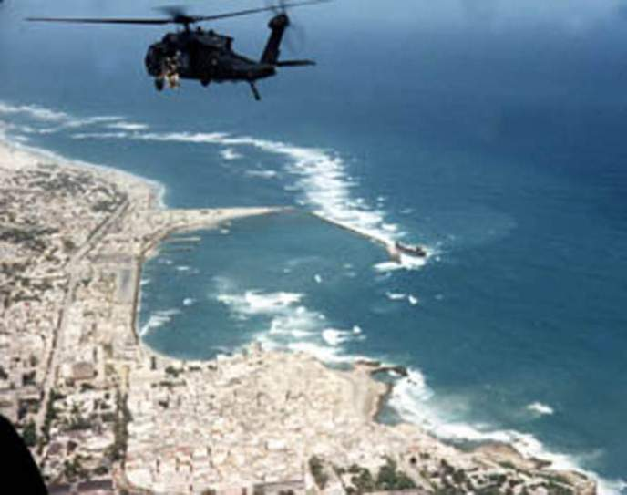
Mogadishu Scenario 2 Helo Hit by RPG Round
Notes:
Second real-world scenario from Mogadishu
Very different tactical situation

Slide 26
Mogadishu Scenario 2 Helo Hit by RPG Round
Hostile and well-armed (AK-47s, RPGs) crowds in an urban environment.
Building assault to capture members of a hostile clan.
Blackhawk helicopter trying to cover helo crash site.
Flying at an altitude of 300 feet.
Notes:
Read the text.

Slide 27
Mogadishu Scenario 2 Helo Hit by RPG Round
Left door gunner with 6-barrel M-134 minigun (4000 rpm)
Hit in left hand by ground fire
Another crew member takes over mini-gun
RPG round impacts under right door gunner
Notes:
Read the text.

Slide 28
Mogadishu Scenario 2 Helo Hit by RPG Round
Windshields are all blown out
Smoke is filling the aircraft
Right minigun is not functioning
Left minigun is without a gunner and is firing uncontrolled
Pilot:
Transiently unconscious - now becoming alert
Notes:
Read the text.

Slide 29
Mogadishu Scenario 2 Helo Hit by RPG Round
Co-pilot
Unconscious - lying forward on the helo’s controls
Crew Member
Right leg blown off above the knee
Lying in puddle of his own blood
Pulsatile bleeding from the stump
Notes:
Read the text.

Slide 30
Mogadishu Scenario 2 Helo Hit by RPG Round
YOU are the person providing care in the helo.
What do you do first?
Notes:
Read the text.

Slide 31
Mogadishu Scenario 2 Helo Hit by RPG Round
Who gets treated first?
Take care of the pilot first.
You want to get him back to flying the aircraft.
The most important thing about medical care in an aircraft is to keep the aircraft in the air.
Stimulate the pilot by shaking him or performing a sternal rub.
Notes:
Advance through these points sequentially. Read (and discuss if appropriate) each point as it appears.

Slide 32
Mogadishu Scenario 2 Helo Hit by RPG Round
Who’s next?
The casualty with the femoral bleeder is next.
He needs a tourniquet.
He should be able to provide self-care if he’s conscious.
The individual in Mogadishu treated himself.
He used an improvised tourniquet.
He survived.
Notes:
Advance through these points sequentially. Read (and discuss if appropriate) each point as it appears.

Slide 33
Mogadishu Scenario 2 Helo Hit by RPG Round
What can you do for the unconscious co-pilot?
First, get him off the controls.
Get him into a supine position.
Establish an airway with an NPA.
Check for external bleeding.
You see none.
Notes:
Advance through these points sequentially. Read (and discuss if appropriate) each point as it appears.

Slide 34
Mogadishu Scenario 2 Helo Hit by RPG Round
Next action?
Check the casualty with the hand injury.
Stop any severe bleeding.
Notes:
Advance through these points sequentially. Read (and discuss if appropriate) each point as it appears.

Slide 35
Mogadishu Scenario 2 Helo Hit by RPG Round
What else?
Radio for help.
Prepare for impact if a crash landing is anticipated.
After impact – secure weapons and ordnance.
Notes:
Advance through these points sequentially. Read (and discuss if appropriate) each point as it appears.

Slide 36
Mogadishu Scenario 2 Helo Hit by RPG Round
End of Scenario

Slide 37
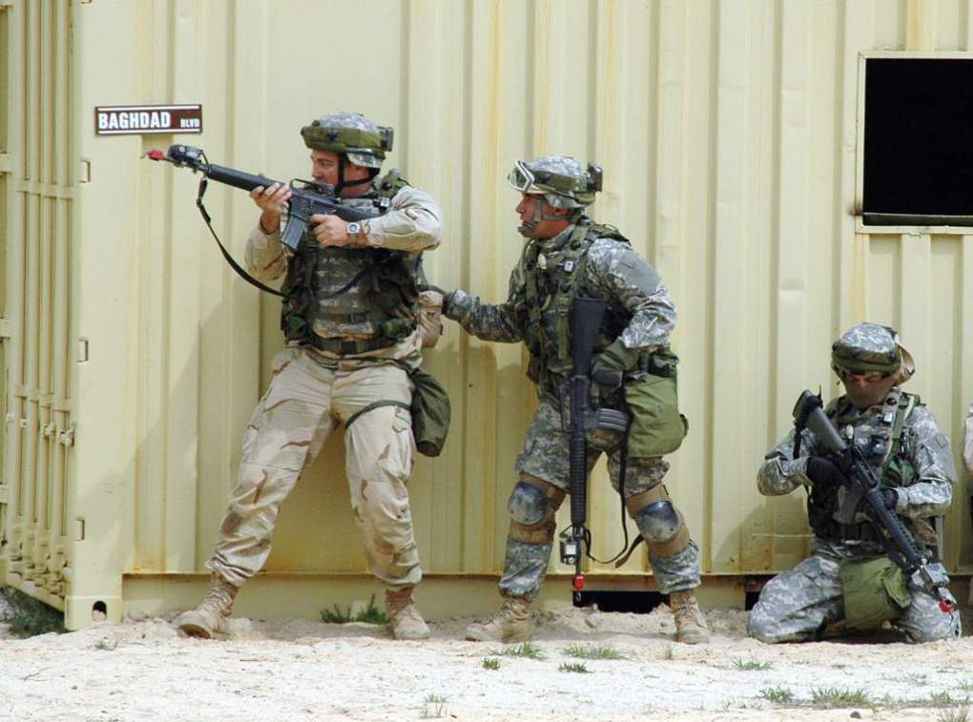
Military Operations in Urban Terrain
Notes:
Now let’s look at a few scenarios that are representative of the kind that we saw recently in Afghanistan.

Slide 38
MOUT Scenario 1
A U.S. ground element is moving on a high-value target in an urban environment.
The first two men in a 8-man patrol are shot by an individual with an automatic weapon while moving down a hallway in a building.
The attacker follows this burst with a grenade.
Notes:
Read the text.

Slide 39
MOUT Scenario 1
One casualty is shot in the abdomen but is conscious.
The second casualty is shot in the shoulder with severe external bleeding.
A third person is unconscious.
The attacker withdraws around a corner.
Notes:
Read the text.

Slide 40
MOUT Scenario 1
YOU are the person providing medical care.
What do you do?
Notes:
Read the text.

Slide 41
MOUT Scenario 1
What are the tactical considerations here?
How many other hostiles are in the house?
Should everyone pursue the hostile(s) and leave care of the casualties for later?
Should the whole unit withdraw to care for casualties?
Should the unit set security and treat the casualties there?
Should the unit split up and have some pursue and others treat?
Splitting the force is most often chosen by previous groups as the best option.
So, you are left with the casualties to proceed with care as per Tactical Field Care Guidelines.
Notes:
Advance through these points sequentially. Read (and discuss if appropriate) each point as it appears.

Slide 42
MOUT Scenario 1
Who gets treated first?
The casualty with the shoulder injury and massive external bleeding.
He’s the most important to treat immediately – he could bleed to death quickly.
What do you do for him?
Stop the bleeding with XStat.
The wound has a deep, narrow tract.
XStat doesn’t require 3 minutes of manual pressure.
Bleeding is controlled
Casualty is alert.
Notes:
Advance through these points sequentially. Read (and discuss if appropriate) each point as it appears.

Slide 43
MOUT Scenario 1
Casualty with shoulder injury: what next?
Airway Management?
He’s conscious and breathing OK.
Respirations?
He’s breathing OK. O2 sat is 95%.
Beware of the risk for tension pneumothorax.
IV?
Not yet.
He’s not in shock at the moment.
You have controlled the bleeding.
Notes:
Advance through these points sequentially. Read (and discuss if appropriate) each point as it appears.

Slide 44
MOUT Scenario 1
Casualty with shoulder injury: what else?
Combat Wound Medication Pack?
Yes.
Pain is becoming increasingly severe.
Should you give fentanyl?
Careful – he may go into shock later due to bleeding from the shoulder wound.
Ketamine is a better choice here.
Notes:
Advance through these points sequentially. Read (and discuss if appropriate) each point as it appears.

Slide 45
MOUT Scenario 1
Who’s next?
Unconscious Casualty
He has no penetrating head trauma.
What do you do first?
Check for massive hemorrhage
You find major bleeding in back of one thigh from a shrapnel wound.
Treatment?
Apply a limb tourniquet.
Notes:
Advance through these points sequentially. Read (and discuss if appropriate) each point as it appears.

Slide 46
MOUT Scenario 1
Unconscious casualty: What else?
Airway Management
Chin-lift/jaw thrust
NP airway
Next?
Check pulse and respirations
You find a rapid, thready pulse and rapid respirations.
You attach a pulse oximeter
O2 sat is 95%
Notes:
Advance through these points sequentially. Read (and discuss if appropriate) each point as it appears.

Slide 47
MOUT Scenario 1
Unconscious casualty: Next?
Circulation
Pelvic binder?
Maybe when you have taken care of the last casualty.
Pelvic fracture is unusual following isolated hand grenade blasts.
Obtain IV/IO access
Administer 1 gm TXA over 10 minutes
Initiate fluid resuscitation with whole blood
Hypothermia prevention
Notes:
Advance through these points sequentially. Read (and discuss if appropriate) each point as it appears.

Slide 48
MOUT Scenario 1
Unconscious casualty: Next?
Analgesia?
None required since he’s unconscious.
Antibiotics?
Yes
IV Ertapenem
Have someone else check for other injuries:
There are none.
Notes:
Advance through these points sequentially. Read (and discuss if appropriate) each point as it appears.

Slide 49
MOUT Scenario 1
Conscious casualty with abdominal GSW is last. What do you do?
Check for massive hemorrhage
Minimal oozing from abdominal GSW
No exit wound
Airway Management?
He’s conscious and breathing OK.
His radial pulse is strong.
Notes:
Advance through these points sequentially. Read (and discuss if appropriate) each point as it appears.

Slide 50
MOUT Scenario 1
Conscious casualty with abdominal GSW: Next?
Does he need IV access?
Yes – he’s at significant risk for developing hemorrhagic shock.
TXA?
Yes. He’s at significant risk of shock due to uncontrolled hemorrhage secondary to abdominal GSW.
Notes:
Advance through these points sequentially. Read (and discuss if appropriate) each point as it appears.

Slide 51
MOUT Scenario 1
Conscious casualty with abdominal GSW: what else?
Fluid resuscitation?
No, not at present – he’s not in shock.
Keep the saline lock.
He may go into shock later.
Analgesia?
He is in moderate pain.
No opioids. Use IV ketamine.
Best for a casualty at risk of shock.
Notes:
Advance through these points sequentially. Read (and discuss if appropriate) each point as it appears.

Slide 52
MOUT Scenario 1
Conscious casualty with abdominal GSW: what else?
Antibiotics?
Yes- IV ertapenem.
Hypothermia prevention?
You bet.
Hypothermia would increase his risk of shock.
Notes:
Advance through these points sequentially. Read (and discuss if appropriate) each point as it appears.

Slide 53
MOUT Scenario 1
End of Scenario

Slide 54
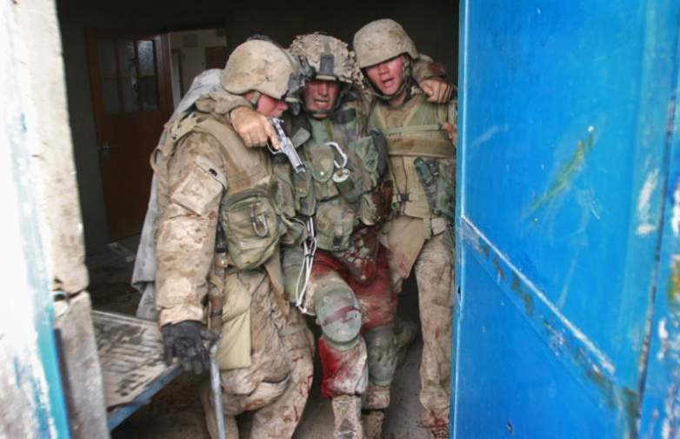
MOUT Scenario 2

Slide 55
MOUT Scenario 2
SCENARIO HISTORY: While on patrol in a city in Iraq, your platoon receives effective direct small arms fire. A unit member falls to the ground, holding his right thigh. The platoon, including you, reacts to the ongoing contact by returning fire.
Notes:
Read the text.

Slide 56
MOUT Scenario 2
You can see that the casualty is bleeding heavily from his thigh wound.
YOU are the person providing medical care for the unit.
What do you do?
Notes:
Read the text.

Slide 57
MOUT Scenario 2
What phase are you in?
Care Under Fire
What should you do for the casualty?
Yell at him to get under cover if he can.
Tell him to put a tourniquet “high and tight” on his wounded leg.
If he can’t control the bleeding, you may have to help him.
If you do, consider a movement plan, suppression of fire, etc.
Notes:
Advance through these points sequentially. Read (and discuss if appropriate) each point as it appears.

Slide 58
MOUT Scenario 2
Should he take his Combat Wound Medication Pack meds now?
No. You are still in Care Under Fire.
Your priorities are to get to cover and return fire if possible.
Notes:
Advance through these points sequentially. Read (and discuss if appropriate) each point as it appears.

Slide 59
MOUT Scenario 2
Scenario continues:
The casualty has moved behind a vehicle.
All hostiles are eliminated or have retreated.
The platoon establishes a secure perimeter.
The platoon leader tells you that you have only one casualty, and that you have a few minutes to work on him before the platoon will have to move.
Notes:
Advance through these points sequentially. Read (and discuss if appropriate) each point as it appears.

Slide 60
MOUT Scenario 2
What phase are you in now?
Tactical Field Care.
Your casualty is alert, in moderate pain, and clutching his right leg. There is blood all over his leg and hands, and a tourniquet is in place on his right thigh.
What is your first concern?
Is life-threatening bleeding controlled?
Notes:
Advance through these points sequentially. Read (and discuss if appropriate) each point as it appears.

Slide 61
MOUT Scenario 2
What do you do to assure hemorrhage control?
Expose the wound.
Blood is oozing from the wound. What next?
Apply another tourniquet 2-3 inches above the bleeding site and tighten it.
Ensure that the bleeding has been stopped and that the distal pulse has been eliminated.
Loosen the high-and-tight tourniquet and reassess bleeding control and distal pulse elimination.
Slide the tourniquet that was high-and-tight down to just proximal to the second tourniquet.
If you need to later, you can further tighten the second tourniquet and tighten the tourniquet you just moved to control bleeding and eliminate distal pulses.
Notes:
Advance through these points sequentially. Read (and discuss if appropriate) each point as it appears.

Slide 62
MOUT Scenario 2
What’s next?
You search quickly for any other life-threatening bleeding, and find none.
Next concern?
Airway management
He is conscious and talking – his airway is OK.
Notes:
Advance through these points sequentially. Read (and discuss if appropriate) each point as it appears.

Slide 63
MOUT Scenario 2
Next?
Breathing.
Breathing is rapid from pain and the situation, but not labored.
What next?
Check for shock.
Mental status is normal. Radial pulse is strong.
Notes:
Advance through these points sequentially. Read (and discuss if appropriate) each point as it appears.

Slide 64
MOUT Scenario 2
Should you start a saline lock?
No, but you’ll watch for any signs of shock.
Does the casualty need IV fluids at this point?
No – he’s not in shock now.
Conserve limited IV fluids until they are really needed.
Notes:
Advance through these points sequentially. Read (and discuss if appropriate) each point as it appears.

Slide 65
MOUT Scenario 2
Next?
Prevent hypothermia?
Ready Heat Blanket – not needed now.
Heat Reflective Shell – not needed now.
Next?
Should you disarm the casualty and take his comms gear?
Yes. He is already distracted by the pain and you anticipate giving him ketamine or narcotics soon.
Notes:
Advance through these points sequentially. Read (and discuss if appropriate) each point as it appears.
This casualty has controlled hemorrhage, so hypothermia prevention is less of a consideration than if he had non-compressible hemorrhage.

Slide 66
MOUT Scenario 2
Next?
Monitoring
Pulse oximetry shows O2 sat is 96%
Analgesia?
OTFC
Notes:
Advance through these points sequentially. Read (and discuss if appropriate) each point as it appears.

Slide 67
MOUT Scenario 2
Next?
Inspect and dress his leg wound.
Reassess for hemorrhage control.
Next?
Assess for other wounds.
You discover tenderness over his anterior lower right chest.
You check his body armor and find corresponding damage compatible with a bullet strike.
Notes:
Advance through these points sequentially. Read (and discuss if appropriate) each point as it appears.

Slide 68
MOUT Scenario 2
Scenario continues:
Your platoon leader tells you the unit will move in 10 minutes to a CASEVAC location.
No enemy contact is expected.
CASEVAC should take about 45-60 minutes.
Should you try to remove the tourniquet and replace it with Combat Gauze?
No – less than two hours tourniquet time is anticipated. Leave it on.
Notes:
Advance through these points sequentially. Read (and discuss if appropriate) each point as it appears.

Slide 69
MOUT Scenario 2
What else do you want to accomplish before TACEVAC?
Reassure the casualty
Document care
Notes:
Advance through these points sequentially. Read (and discuss if appropriate) each point as it appears.

Slide 70
MOUT Scenario 2
Scenario continues:
You have now moved to the CASEVAC site. The platoon establishes security.
You check the patient and notice that he is confused and breathing rapidly.
You check his thigh wound and find that the tourniquet just above the wound has become loose and the dressing is soaked with blood.
Notes:
Advance through these points sequentially. Read (and discuss if appropriate) each point as it appears.
It is fairly common for limb tourniquets to loosen during casualty movement or as muscle tension changes.

Slide 71
MOUT Scenario 2
The tourniquet is loose and the wound is bleeding again. What do you do?
Re-tighten the tourniquet nearest the wound.
Tighten the proximal tourniquet, too.
You remove the bloody dressing to re-assess hemorrhage control:
Bleeding is now controlled.
Distal pulses are not present.
You re-dress the wound.
Notes:
Advance through these points sequentially. Read (and discuss if appropriate) each point as it appears.

Slide 72
MOUT Scenario 2
Scenario continues:
Casualty becomes unconscious from shock. What next?
Establish IV/IO access if not done before.
Immediately administer 1 gm TXA in 100cc NS over 10 minutes.
Begin infusion of whole blood.
Notes:
Advance through these points sequentially. Read (and discuss if appropriate) each point as it appears.
If you don’t have whole blood, use the resuscitation fluids you do have.

Slide 73
MOUT Scenario 2
What next?
Nasopharyngeal airway - casualty is unconscious
Recovery position
Continue resuscitation
Prepare for evacuation and transport ASAP
Notes:
Advance through these points sequentially. Read (and discuss if appropriate) each point as it appears.

Slide 74
MOUT Scenario 2
End of Scenario

Slide 75
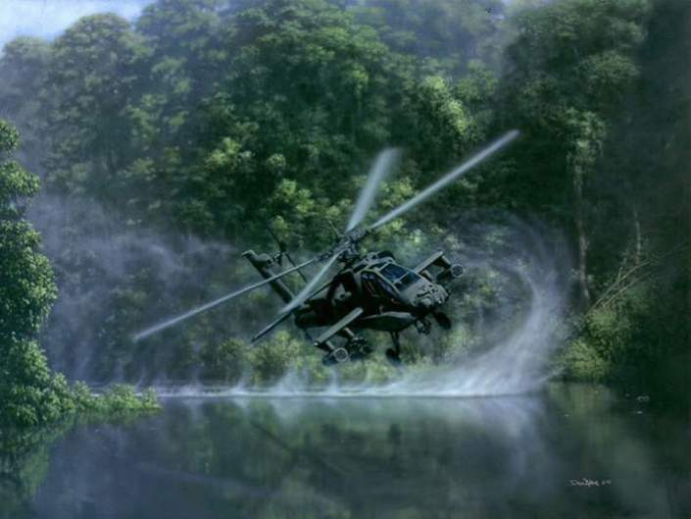
MOUT Scenario 3

Slide 76
MOUT Scenario 3
SCENARIO HISTORY: While on patrol in the city of Mosul, an infantry platoon comes under small arms fire. The point man is hit and falls to the ground. The platoon reacts to the contact, rapidly eliminating the ambushing hostiles. There are no other casualties. The platoon leader tells you take care of the casualty while the others establish a secure perimeter.
Notes:
Read the text.

Slide 77
MOUT Scenario 3
You move to the casualty, and quickly assess for life-threatening conditions:
Gunshot Wound (GSW)
Entrance at right upper back
Exit in right armpit
Heavy, pulsatile bleeding from the exit wound
Breathing OK, though a little fast
No other wounds
YOU are the person providing medical care.
What do you do?
Notes:
Advance through these points sequentially. Read (and discuss if appropriate) each point as it appears.

Slide 78
MOUT Scenario 3
It has been about 4 minutes since the casualty was wounded. What is your immediate concern?
Life threatening hemorrhage from the wound in the armpit.
What phase of care are you in?
TFC
Notes:
Advance through these points sequentially. Read (and discuss if appropriate) each point as it appears.

Slide 79
MOUT Scenario 3
As the first responder caring for this casualty, what do you do next?
Expose the wound.
Pack the wound with XStat.
Hold direct pressure for a minimum of 3 minutes.
Notes:
Advance through these points sequentially. Read (and discuss if appropriate) each point as it appears.
Holding manual pressure over XStat is optional. It is a good idea here since you have only one casualty in TFC and are in no hurry to move.

Slide 80
MOUT Scenario 3
What do you do while holding pressure?
Talk to the casualty
Checks both airway and mental status
External bleeding appears controlled but the casualty is drowsy.
Notes:
Advance through these points sequentially. Read (and discuss if appropriate) each point as it appears.

Slide 81
MOUT Scenario 3
What next?
Apply a pressure dressing over the XStat.
Check for other sources of bleeding.
None found.
Check the left radial pulse.
It is not palpable.
Notes:
Advance through these points sequentially. Read (and discuss if appropriate) each point as it appears.

Slide 82
MOUT Scenario 3
What next?
Check breathing.
Slightly fast but not obviously labored.
Breath sounds are absent on the right.
Should you treat for a tension pneumothorax here?
Yes. The casualty has a chest wound, rapid breathing, absent breath sounds, and shock.
Notes:
Advance through these points sequentially. Read (and discuss if appropriate) each point as it appears.

Slide 83
MOUT Scenario 3
You perform needle decompression of the right chest.
At the 5th intercostal space at the anterior axillary line with the patient in supine position
There is no hiss of escaping air.
You see no improvement.
You decompress at the 2nd intercostal space at the mid-clavicular line.
There is no hiss of escaping air.
You see no improvement.
Notes:
Advance through these points sequentially. Read (and discuss if appropriate) each point as it appears.

Slide 84
MOUT Scenario 3
The casualty may be in hemorrhagic shock.
What next?
Start an IV.
What do you give first?
TXA: 1gm over 10 minutes
What next?
You start the first unit of dried plasma. (Because this is the only blood component you have been trained to infuse and are authorized to carry.)
Notes:
Advance through these points sequentially. Read (and discuss if appropriate) each point as it appears.
You tried twice to relieve a possible tension pneumothorax and failed to achieve improvement in the casualty. There may be no tension physiology. You can wait no longer to address hemorrhagic shock.

Slide 85
MOUT Scenario 3
Scenario continues:
Ten minutes pass. Plasma is going in.
External bleeding is controlled by the XStat.
Casualty is now unconscious and does not respond to deep pain.
There is no reading for O2 sat displayed on the pulse ox.
Carotid pulse is not palpable.
His breathing has stopped.
Arrival of MEDEVAC helicopter is expected to take at least an hour.
Notes:
Advance through these points sequentially. Read (and discuss if appropriate) each point as it appears.

Slide 86
MOUT Scenario 3
What next?
You perform bilateral needle decompression of possible tension pneumothorax.
You do this and there is no improvement.
You recheck the airway to make sure it’s clear.
A second person confirms no pulse or breathing.
What next?
CPR?
No
Notes:
Advance through these points sequentially. Read (and discuss if appropriate) each point as it appears.

Slide 87
MOUT Scenario 3
Why not perform CPR?
It won’t help!
Individuals in traumatic cardiac arrest have little to no chance of surviving more than 10 minutes without surgical care.
Notes:
Advance through these points sequentially. Read (and discuss if appropriate) each point as it appears.
As of 2017, there have been no reports of any US casualties in Iraq or Afghanistan surviving a traumatic cardiac arrest that occurred prior to TACEVAC.

Slide 88
MOUT Scenario 3
You inform your platoon leader that the casualty has died.
The cause of death is probably internal hemorrhage from the GSW.
The decision to be made now is how and when to transport your teammate’s body off the battlefield.
Document the injuries and the care rendered.
Notes:
Advance through these points sequentially. Read (and discuss if appropriate) each point as it appears.

Slide 89
MOUT Scenario 3
End of Scenario

Slide 90
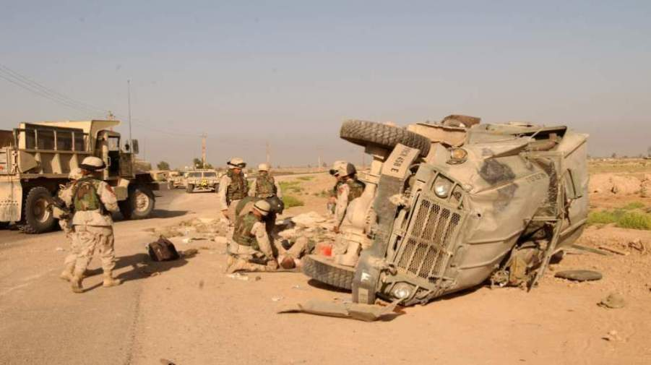
MOUT Scenario 4

Slide 91
MOUT Scenario 4
SCENARIO HISTORY: You are riding with a squad in the back of a cargo Humvee. When you stop at an intersection, a lone attacker fires an RPG at your vehicle. It is poorly aimed, and strikes the ground beside the Humvee. The vehicle sustains moderate damage and is not able to move. Everyone scrambles out of the vehicle. The last person out is complaining of chest pain and shortness of breath. You and the others are uninjured.
Notes:
Read the text.

Slide 92
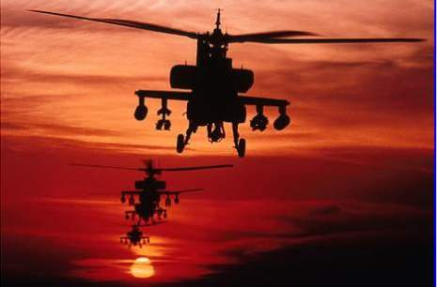
MOUT Scenario 4
Security is set.
There is no further hostile fire.
YOU are the person providing medical care.
What do you do?
Notes:
Advance through these points sequentially. Read (and discuss if appropriate) each point as it appears.

Slide 93
MOUT Scenario 4
What phase are you in?
Tactical Field Care
You examine the casualty and find:
She is alert and talking normally, but in severe pain.
She has a shrapnel wound in her right lateral chest - no exit wound.
Entrance wound is a sucking chest wound.
Her right thumb is missing and the wound is oozing a little blood.
There is no major external bleeding.
Notes:
Advance through these points sequentially. Read (and discuss if appropriate) each point as it appears.

Slide 94
MOUT Scenario 4
What do you do first?
Cover the chest wound with a vented chest seal.
Apply the dressing at end-exhalation.
Have her breathe all the way out and put it on before she breathes in again.
This makes the casualty more comfortable.
Her O2 sat improves from 91% to 97%.
Notes:
Advance through these points sequentially. Read (and discuss if appropriate) each point as it appears.

Slide 95
MOUT Scenario 4
What next?
She’s at risk for shock.
You start an IV and give 1 gm of TXA.
Next?
Analgesia
Ketamine 50 mg IM immediately after starting the TXA infusion.
What else?
You have someone else dress her thumb wound while you were giving the ketamine.
Notes:
Advance through these points sequentially. Read (and discuss if appropriate) each point as it appears.

Slide 96
MOUT Scenario 4
You are worried about internal bleeding from the chest wound. What are you going to do about it?
Monitor for changes in radial pulse strength and mental status.
Casualty is alert and now breathing OK.
Radial pulse is strong.
O2 sat is 97%.
Notes:
Advance through these points sequentially. Read (and discuss if appropriate) each point as it appears.

Slide 97
MOUT Scenario 4
What next?
Look for other wounds.
You find none.
What next?
Hypothermia prevention.
Notes:
Advance through these points sequentially. Read (and discuss if appropriate) each point as it appears.

Slide 98
MOUT Scenario 4
Your casualty says that her pain is still very severe. What else do you want to do for her?
Can you give her a fentanyl lozenge?
No – she’s at risk for hemorrhagic shock and increasing respiratory distress.
She’s alert with good O2 sat and breathing well.
She’s not in shock at this point, BUT – she has a chest injury and probably has internal bleeding.
IV ketamine is a good next option since you have an IV and you have finished the TXA infusion.
Monitor oxygen saturation and breathing carefully.
Notes:
Advance through these points sequentially. Read (and discuss if appropriate) each point as it appears.
Unlike fentanyl and morphine, ketamine will not lower cardiac output or blood pressure, and is not a respiratory depressant. Ketamine is a very safe drug and the dose can be increased until analgesia is achieved. Since you have an IV, give it IV since that works slightly faster than IM.

Slide 99
MOUT Scenario 4
What’s next?
Antibiotics.
Have her take the moxifloxacin in her CWMP.
Your casualty is stable. What steps do you take now?
Communicate her status to your squad leader.
Begin TACEVAC preparations.
Document care on the TCCC Casualty Card.
Notes:
Advance through these points sequentially. Read (and discuss if appropriate) each point as it appears.
She is alert and can take meds by mouth. Having her take the PO moxifloxacin saves you the time and trouble of mixing the ertapenem and hanging the IV infusion.

Slide 100
MOUT Scenario 4
Scenario continues:
You are 8 miles from a Combat Support Hospital (CSH).
A helicopter will not be available for an hour.
By ground vehicle, the trip will take 35 minutes.
A mounted patrol is dispatched to take your casualty to the CSH.
It has now been about 40 minutes since the RPG attack.
You are in route to the CSH.
Notes:
Advance through these points sequentially. Read (and discuss if appropriate) each point as it appears.

Slide 101
MOUT Scenario 4
The casualty tells you she’s having increasing trouble breathing. What do you do?
Assess her airway. It’s clear.
Breathing is rapid and labored.
The vented chest seal is secure.
Her O2 sat has dropped to 80%.
Notes:
Advance through these points sequentially. Read (and discuss if appropriate) each point as it appears.

Slide 102
MOUT Scenario 4
What’s the presumptive diagnosis?
Tension pneumothorax.
What are you going to do about it?
You lift one side of the chest seal for a few seconds.
There is a rush of air from the wound confirming the tension pneumothorax.
Notes:
Advance through these points sequentially. Read (and discuss if appropriate) each point as it appears.

Slide 103
MOUT Scenario 4
The casualty’s respiratory distress is relieved.
O2 sat goes up to 94%.
Good job!
Consider replacing the chest seal, since the vent on the first one apparently failed to do it’s job.
Continue to monitor.
If distress or hypoxia recurs, burp the chest seal again.
Continue TACEVAC preparations.
Notes:
Advance through these points sequentially. Read (and discuss if appropriate) each point as it appears.

Slide 104
MOUT Scenario 4
End of Scenario

Slide 105
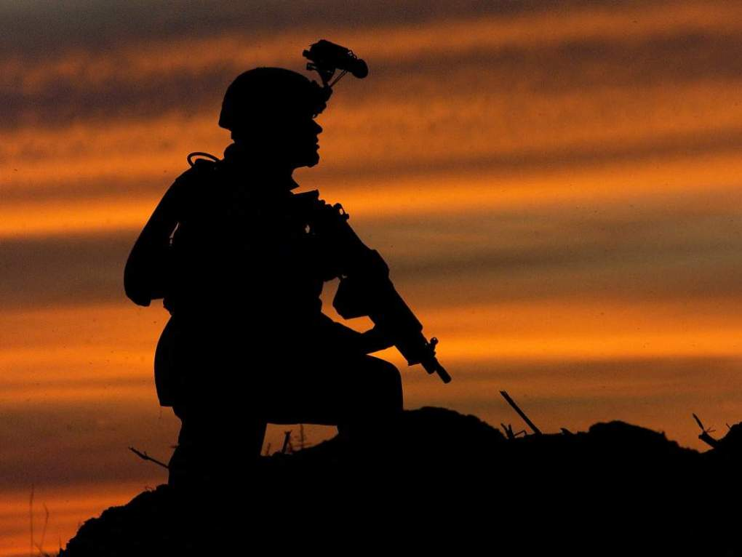
Questions?

Slide 106
Tactical Combat Casualty Care
Casualty scenarios on the battlefield usually entail both medical and tactical problems.
Emergency actions must address both.
Medical personnel should be involved in mission planning.
Notes:
Summary:
Good tactical medicine HAS to be a combination of good tactics and good medicine.
Bring your leadership into the medical plan.
Combat leaders must understand combat medicine.

Slide 107
Scenario-Based Planning
The TCCC guidelines for combat trauma scenarios are advisory rather than directive in nature.
Rarely does an actual tactical situation exactly reflect the conditions described in planning scenarios.
Unit medics/corpsmen/PJs will typically need to modify the medical care plan to optimize it for the real scenario.
Notes:
Read the text.

Slide 108
The Three Objectives of TCCC
Treat the casualty
Prevent additional casualties
Complete the mission
Notes:
Once more…..

Slide 109
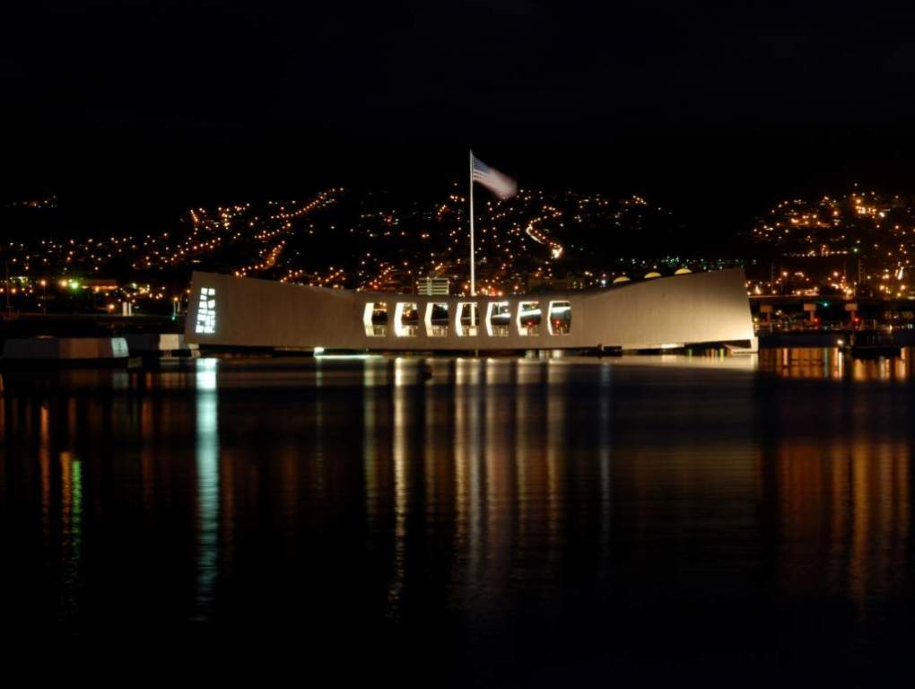
Questions?

